Slide 1

Data Mining Competition
Game Review Classification
Game
Presented By
Amit Das | Ashraful Tauhid | Mahmudul Hasan Robin

Slide 2
MEET OUR TEAM
Team RoadBlock
Amit Das
Ashraful Tauhid
Mahmudul Hasan Robin
ID: 20603120
ID: 20576202
ID: 20602571

Slide 3
I
N
T
R
O
D
U
C
T
I
O
N

Slide 4
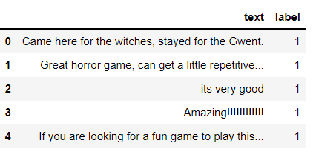

INTRODUCTION
Data Set:
1000 Raw Game Review for Training
792 Review for Prediction
Fig: Sample Training Data

Slide 5
P
R
E
-
P
R
O
C
E
S
S
I
N
G

Slide 6

PRE-PROCESSING
The steps of pre-processing followed in this project is as follows:
Stop words
Stemming
Vectorization

Slide 7
PRE-PROCESSING PACKAGES
The steps of pre-processing followed in this project is as follows:
NLTK corpus stopwords
Using NLTK PorterStemmer
Sklearn Count Vectorizer
Stop words
Stemming
Vectorization

Slide 8
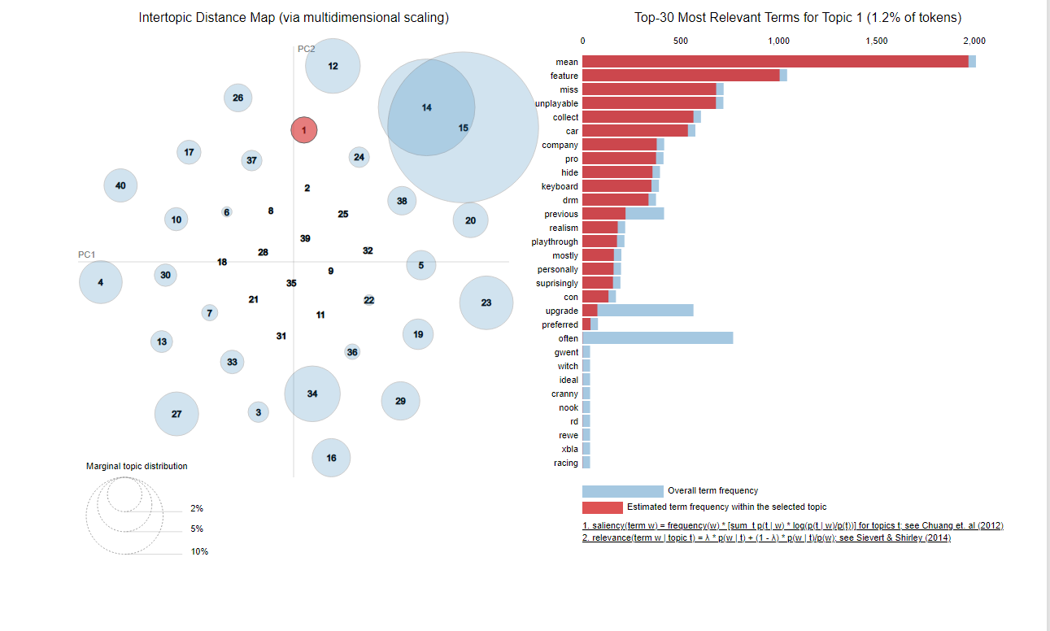
DATA VISUALIZATION
Topic Modeling
Using Gensim and pyLDAvis packages
…. Then further cleaning the data

Slide 9
D
I
F
F
E
R
E
N
T
M
O
D
E
L
S

Slide 10

DIFFERENT MODELS
Traditional Machine Learning Models:
Multinomial Naive Bayes
Logistic Regression
Gaussian NB
Transfer Learning:
DistilBERT

Slide 11

ML MODEL’S ACCURACIES
Multinomial Naive Bayes
Gaussian NB
Logistic Regression

Slide 12
P
R
O
P
O
S
E
D
M
O
D
E
L

Slide 13
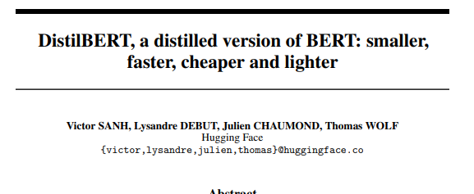


PROPOSED MODEL
Transfer Learning:
DistilBERT: We have used transformer method's distilBERT language model. The proposed version of the distilBERT model is tweeter-based language model for sentiment analysis.
Accuracy: 0.86868
Fig: Original Paper

Slide 14
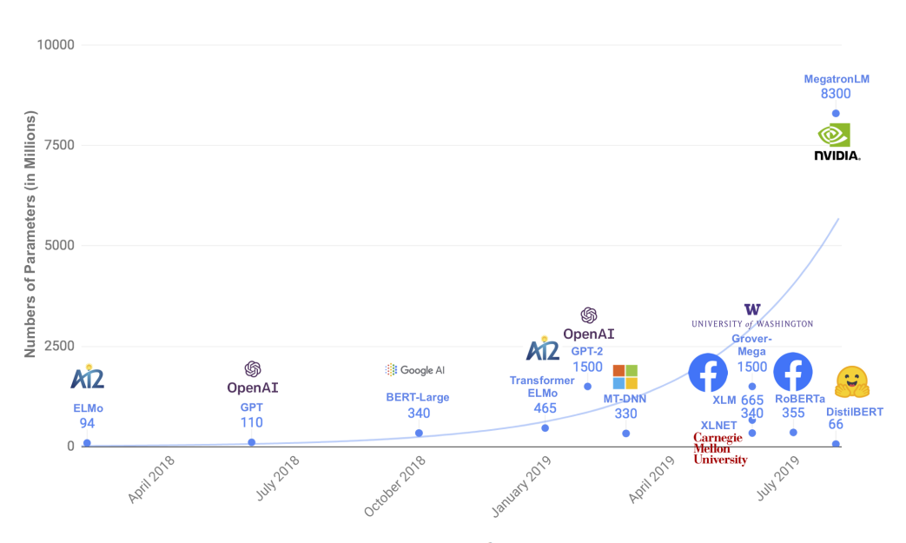

DistilBERT Model
Comparison between BERT and DistilBERT:
40% less parameter to train than BERT model
60% faster than BERT
Fig: Parameter Comparison (From paper)

Slide 15
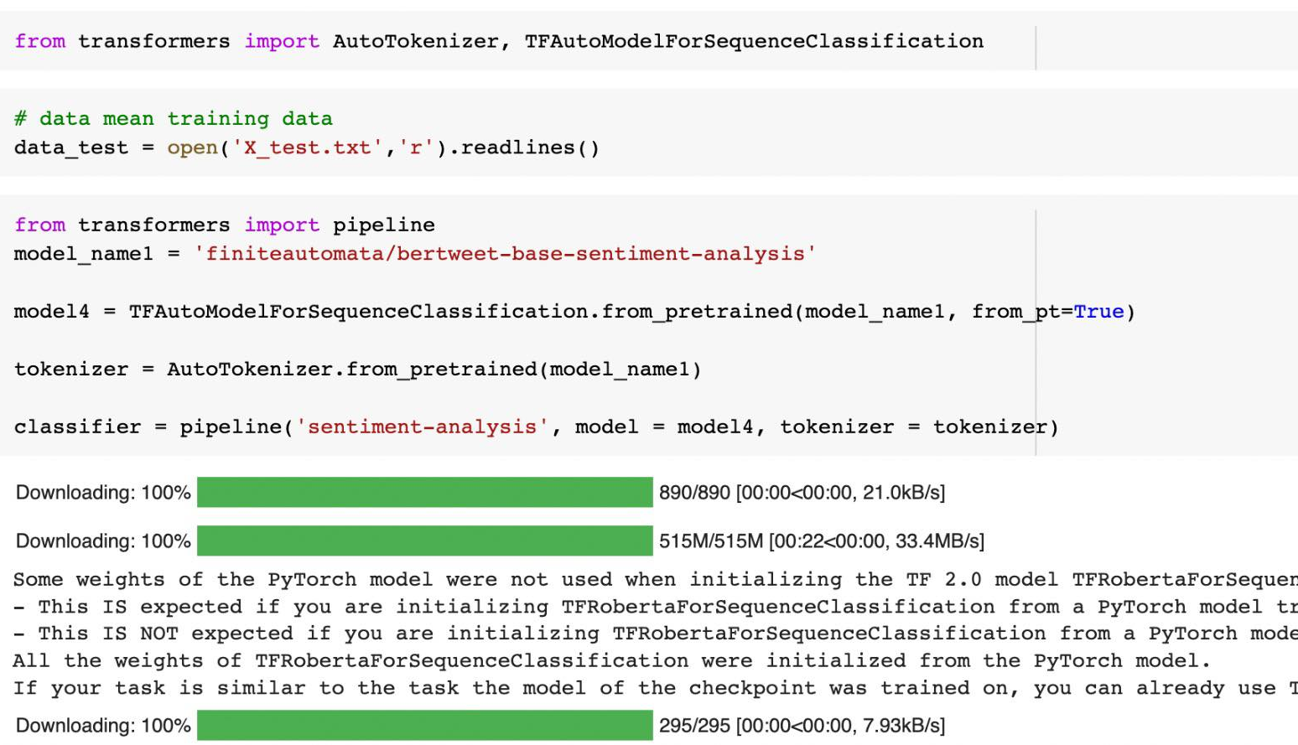
DistilBERT IMPLEMENTATION
PyTorch Environment
This figure shows the detailed processing for the language using the testing data.
As the proposed model takes huge training time using the training data, we have also shown the pretrained model processing for testing data output.

Slide 16
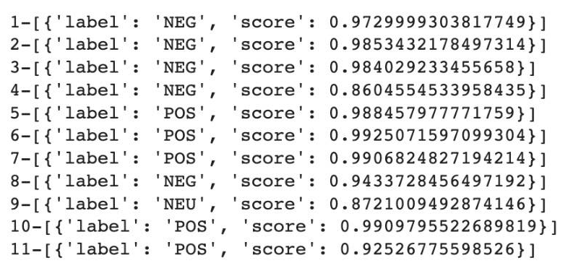

DistilBERT IMPLEMENTATION
PyTorch Environment
This figure shows the sample output labels for each images.
It depicts the probability of being positive or negative for each of the images based on the accuracy metric.
The output are coming from the proposed model using the training dataset.
Fig: Sample output label on test data

Slide 17
L
I
M
I
T
A
T
I
O
N
S

Slide 18

LIMITATIONS
Resource intensive
Time consuming (~2-3 days to train)
Difficult to install in local machine (Complex perquisites)

Slide 19
C
O
N
C
L
U
S
I
O
N

Slide 20

CONCLUSION
Gained experience to work with raw real-world data
Challenging but learned a greatly from hands-on competition
Came across different situations and tried different algorithms to tackle the tasks and complete within the time constraint.

Slide 21
T
H
A
N
K
Y
O
U

